Slide 1
Al-Farabi Kazakh National University
Higher School of Medicine
Department of Fundamental Medicine
Structural genomics. Human genome
Lecturer and creator: PhD Pinsky Ilya Vladimirovich
Notes:
Weaver, PART I

Slide 2
LEARNING OUTCOMES
As a result of the lesson you will be able to:
1. Give the definition to the following terms: "gene", "genotype", "genome", "genetics" and "genomics".
2. Characterize the differences between structural and functional genomics.
3. Analyze the history of the Human Genome Project. What is the meaning of this project?
4. Discuss the applications of Human Genome Project in medicine and pharmacy and their future perspectives.
5. Explain the structure of human genome (nuclear and mitochondrial genome, structure and functions of coding and non-coding DNA).

Slide 3
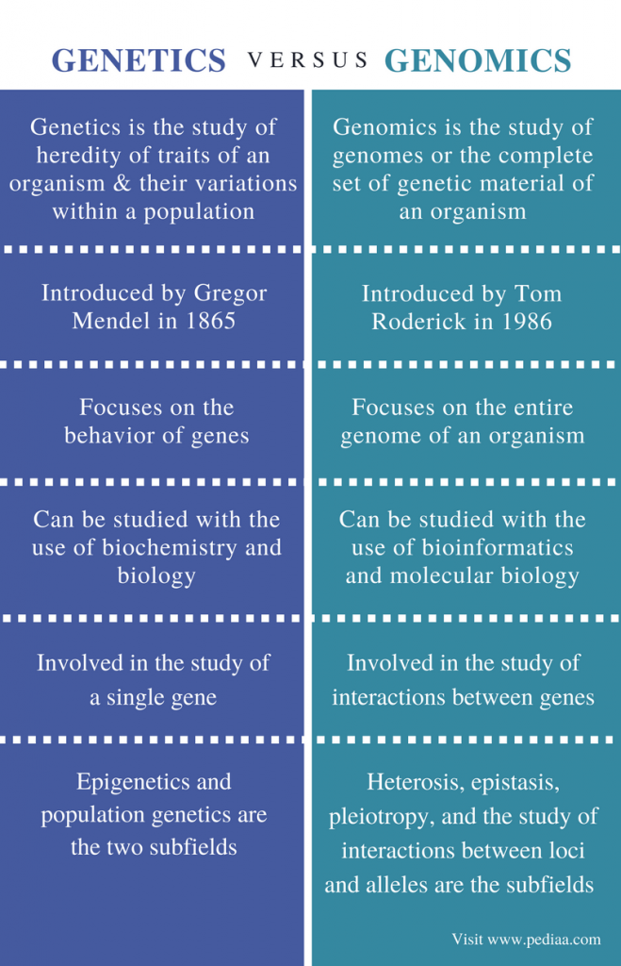

Slide 4
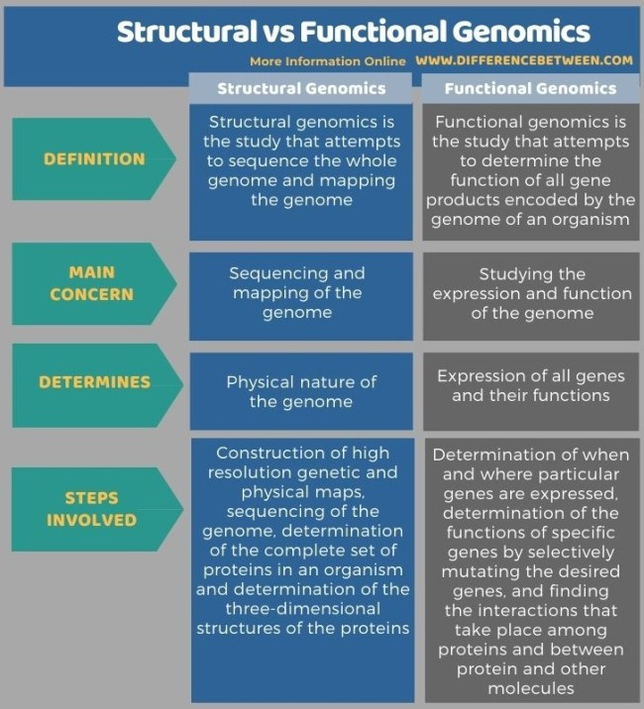
https://www.google.com/url?sa=i&url=https%3A%2F%2Fwww.differencebetween.com%2Fdifference-between-structural-and-functional-genomics%2F&psig=AOvVaw23Jc1aXZWnpaE6Xi2x1drr&ust=1643392891451000&source=images&cd=vfe&ved=0CAwQjhxqFwoTCJiw4uDB0vUCFQAAAAAdAAAAABAJ

Slide 5
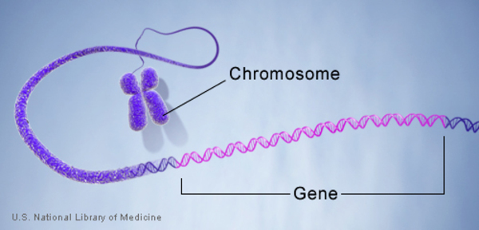
https://www.google.com/url?sa=i&url=https%3A%2F%2Fsinaumedia.com%2Fgene-mutations-and-their-levels%2F&psig=AOvVaw1AwFnYrec7thO5Gf0pcqRU&ust=1643393520703000&source=images&cd=vfe&ved=0CAsQjRxqFwoTCICArI7E0vUCFQAAAAAdAAAAABAZ

Slide 6
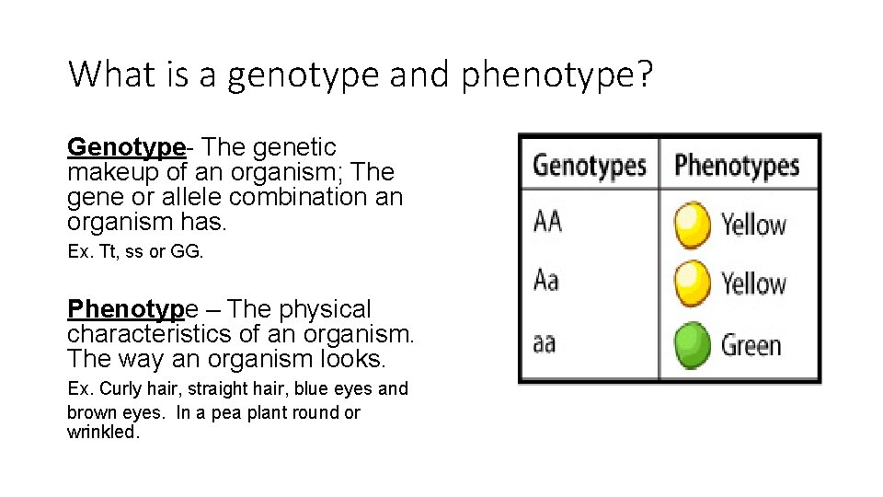
https://www.google.com/url?sa=i&url=https%3A%2F%2Fslidetodoc.com%2Fgene-symbols-and-punnett-squares-notes-what-is%2F&psig=AOvVaw1KRuIgfkDJ4Dm-LvxyiFZc&ust=1643393204136000&source=images&cd=vfe&ved=0CAsQjRxqFwoTCNCZzffC0vUCFQAAAAAdAAAAABAW

Slide 7
Human genome
The human genome is a complete set of nucleic acid sequences in human cells, encoded as DNA within the 23 chromosome pairs in cell nuclei and in a small DNA molecule found within individual mitochondria. These are usually treated separately as the nuclear genome and the mitochondrial genome. Human genome includes both protein-coding DNA genes and noncoding DNA.
Human genome contains more than 3 billion base pairs and 25-30 thousand protein coding genes.

Slide 8
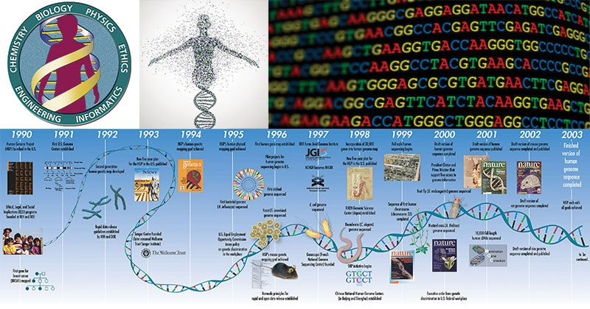
https://www.google.com/url?sa=i&url=https%3A%2F%2Fmicrobenotes.com%2Fthe-human-genome-project%2F&psig=AOvVaw2cyEn_sBdI_Q3-mHXaQlQh&ust=1643394078217000&source=images&cd=vfe&ved=0CAwQjhxqFwoTCMDi8JfG0vUCFQAAAAAdAAAAABAV

Slide 9
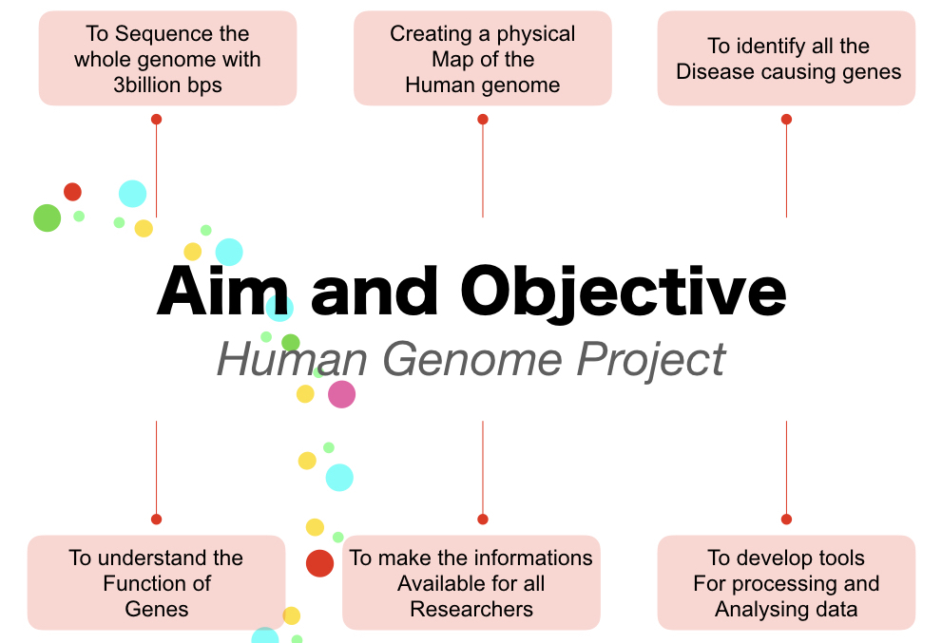
https://www.google.com/url?sa=i&url=https%3A%2F%2Fgeneticeducation.co.in%2Fthe-human-genome-project-aims-objectives-techniques-and-outcomes%2F&psig=AOvVaw2LbSxcKgoI1_-RcmBCyBVI&ust=1638796078165000&source=images&cd=vfe&ved=0CAwQjhxqFwoTCNDO3qbdzPQCFQAAAAAdAAAAABAY

Slide 10
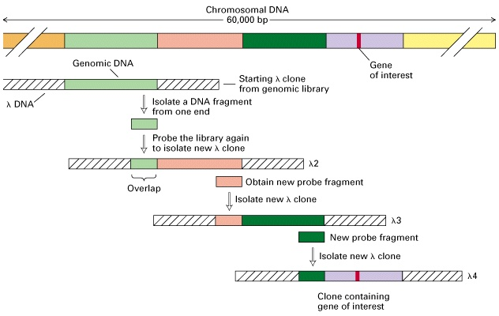
Chromosome walking
https://www.google.com/url?sa=i&url=http%3A%2F%2Fgvbioteck.blogspot.com%2F2012%2F09%2Fchromosome-walking.html&psig=AOvVaw1Efr8a66zZIvm2f80hb2UM&ust=1614627414190000&source=images&cd=vfe&ved=2ahUKEwjbkIH9qY3vAhWYuyoKHan9AbIQr4kDegUIARC2AQ

Slide 11
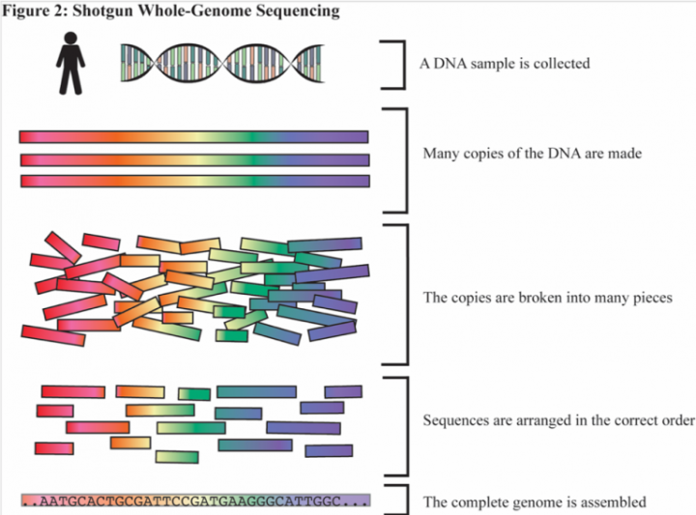
https://www.google.com/url?sa=i&url=https%3A%2F%2Fsitn.hms.harvard.edu%2Fflash%2F2019%2Flessons-from-the-human-genome-project%2F&psig=AOvVaw2LbSxcKgoI1_-RcmBCyBVI&ust=1638796078165000&source=images&cd=vfe&ved=2ahUKEwjAlYei3cz0AhWRzSoKHZ6vBHkQr4kDegUIARDMAQ

Slide 12
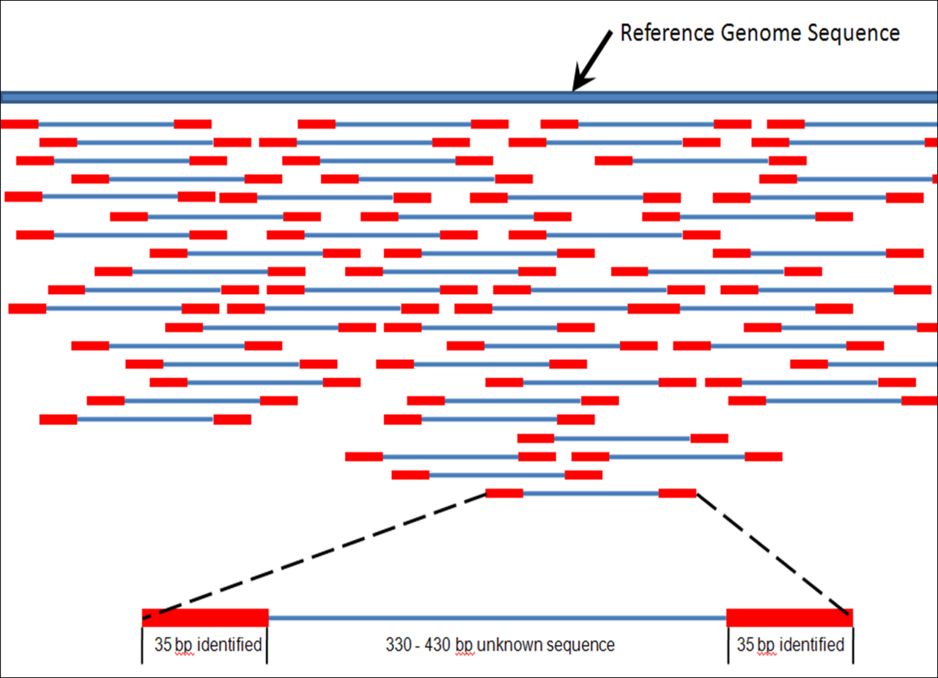
Genome assembling
https://en.wikipedia.org/wiki/Genomics#/media/File:Mapping_Reads.png

Slide 13
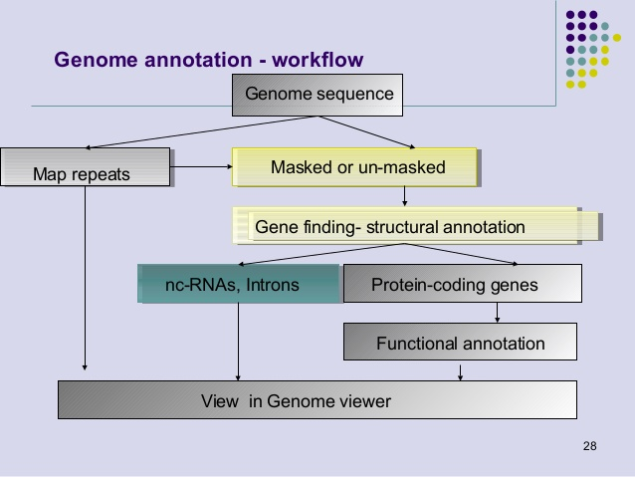
https://www.google.com/url?sa=i&url=https%3A%2F%2Fwww.slideshare.net%2Fkaranppt%2Fgenome-annotation-2013&psig=AOvVaw3W0yVtMND0yOoaRAbiACi3&ust=1614628815714000&source=images&cd=vfe&ved=2ahUKEwjtt6eZr43vAhXaBncKHVEDCNQQr4kDegUIARDIAQ

Slide 14
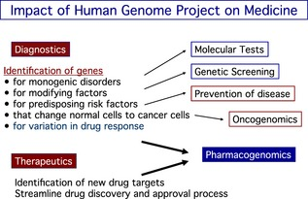
https://www.google.com/url?sa=i&url=https%3A%2F%2Fwww.researchgate.net%2Ffigure%2FExpected-impact-of-the-human-genome-project-on-medicine-as-envisioned-in-2003_fig2_260109480&psig=AOvVaw0T0HkqSAX-gzjplNLjYK4o&ust=1638795190259000&source=images&cd=vfe&ved=0CAwQjhxqFwoTCNi7sf_ZzPQCFQAAAAAdAAAAABAM

Slide 15
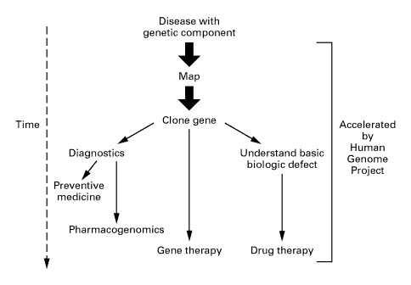
https://www.google.com/url?sa=i&url=https%3A%2F%2Fwww.nejm.org%2Fdoi%2Ffull%2F10.1056%2Fnejm199907013410106&psig=AOvVaw2cyEn_sBdI_Q3-mHXaQlQh&ust=1643394078217000&source=images&cd=vfe&ved=0CAwQjhxqFwoTCMDi8JfG0vUCFQAAAAAdAAAAABAa

Slide 16
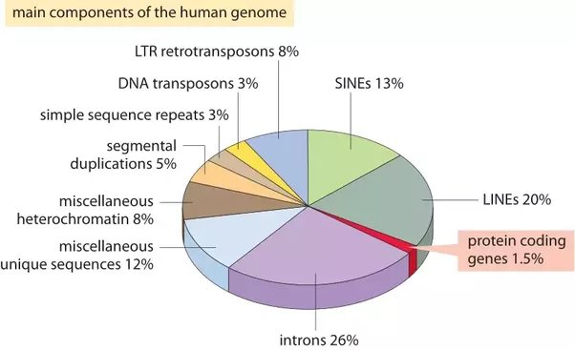
https://www.google.com/url?sa=i&url=https%3A%2F%2Fwww.quora.com%2FIs-non-coding-DNA-important-to-an-organism-in-any-way-Why-is-it-studied&psig=AOvVaw1RYAwMokIj3VJG99IRaVr6&ust=1638797212197000&source=images&cd=vfe&ved=0CA0QjhxqFwoTCLjc3sPhzPQCFQAAAAAdAAAAABBg

Slide 17
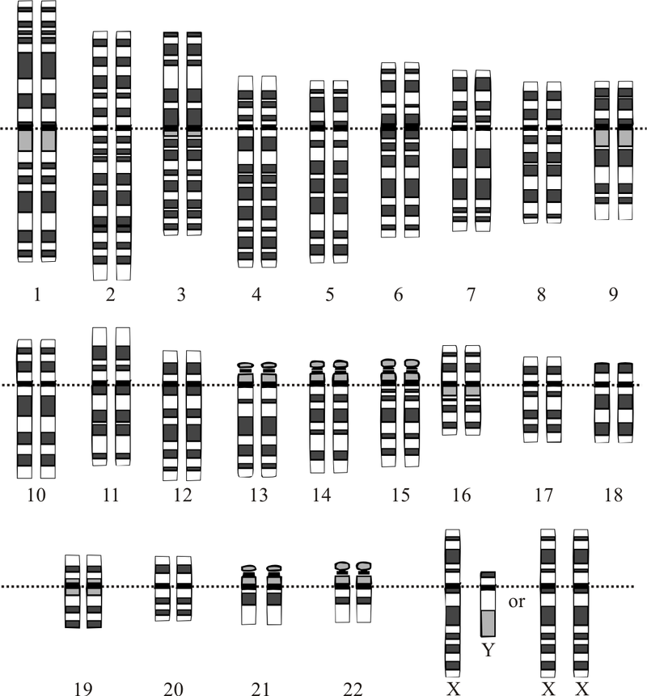
Courtesy: National Human Genome Research Institute - Modified from Human Genome Project From en: with same file name, contributor: en:User:TedE

Slide 18
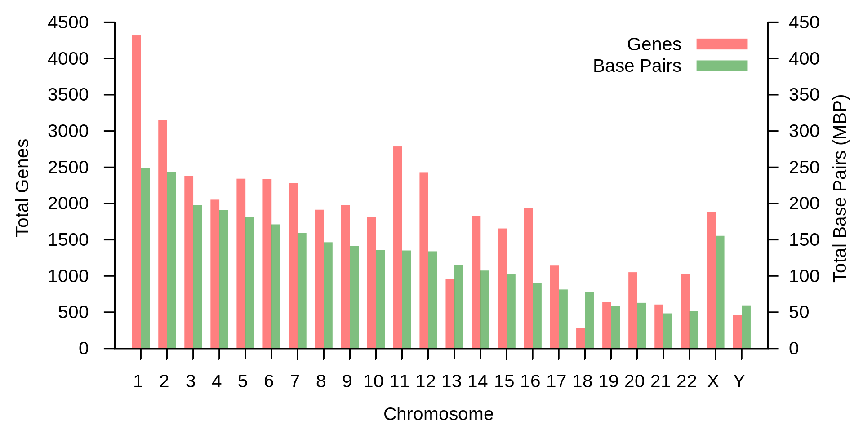
By Friend of a friends - Own work, CC BY-SA 3.0, https://commons.wikimedia.org/w/index.php?curid=18594472

Slide 19
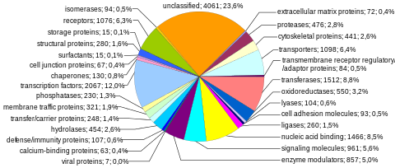
https://www.google.com/url?sa=i&url=https%3A%2F%2Fen.wikipedia.org%2Fwiki%2FHuman_genome&psig=AOvVaw2Aw7Ox0xLbc8llqIMRNvCF&ust=1638789843585000&source=images&cd=vfe&ved=0CAwQjhxqFwoTCLDYnY3GzPQCFQAAAAAdAAAAABAD

Slide 20
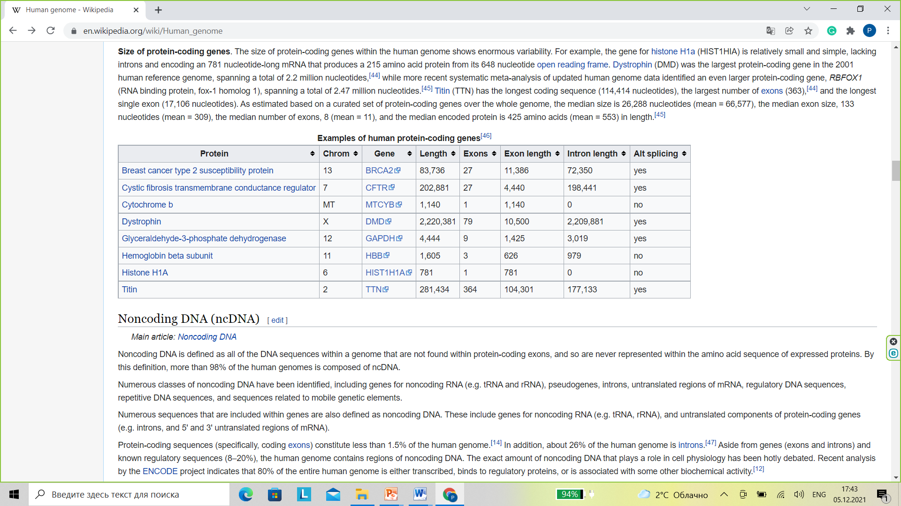
Ensembl genome browser (July 2012)

Slide 21
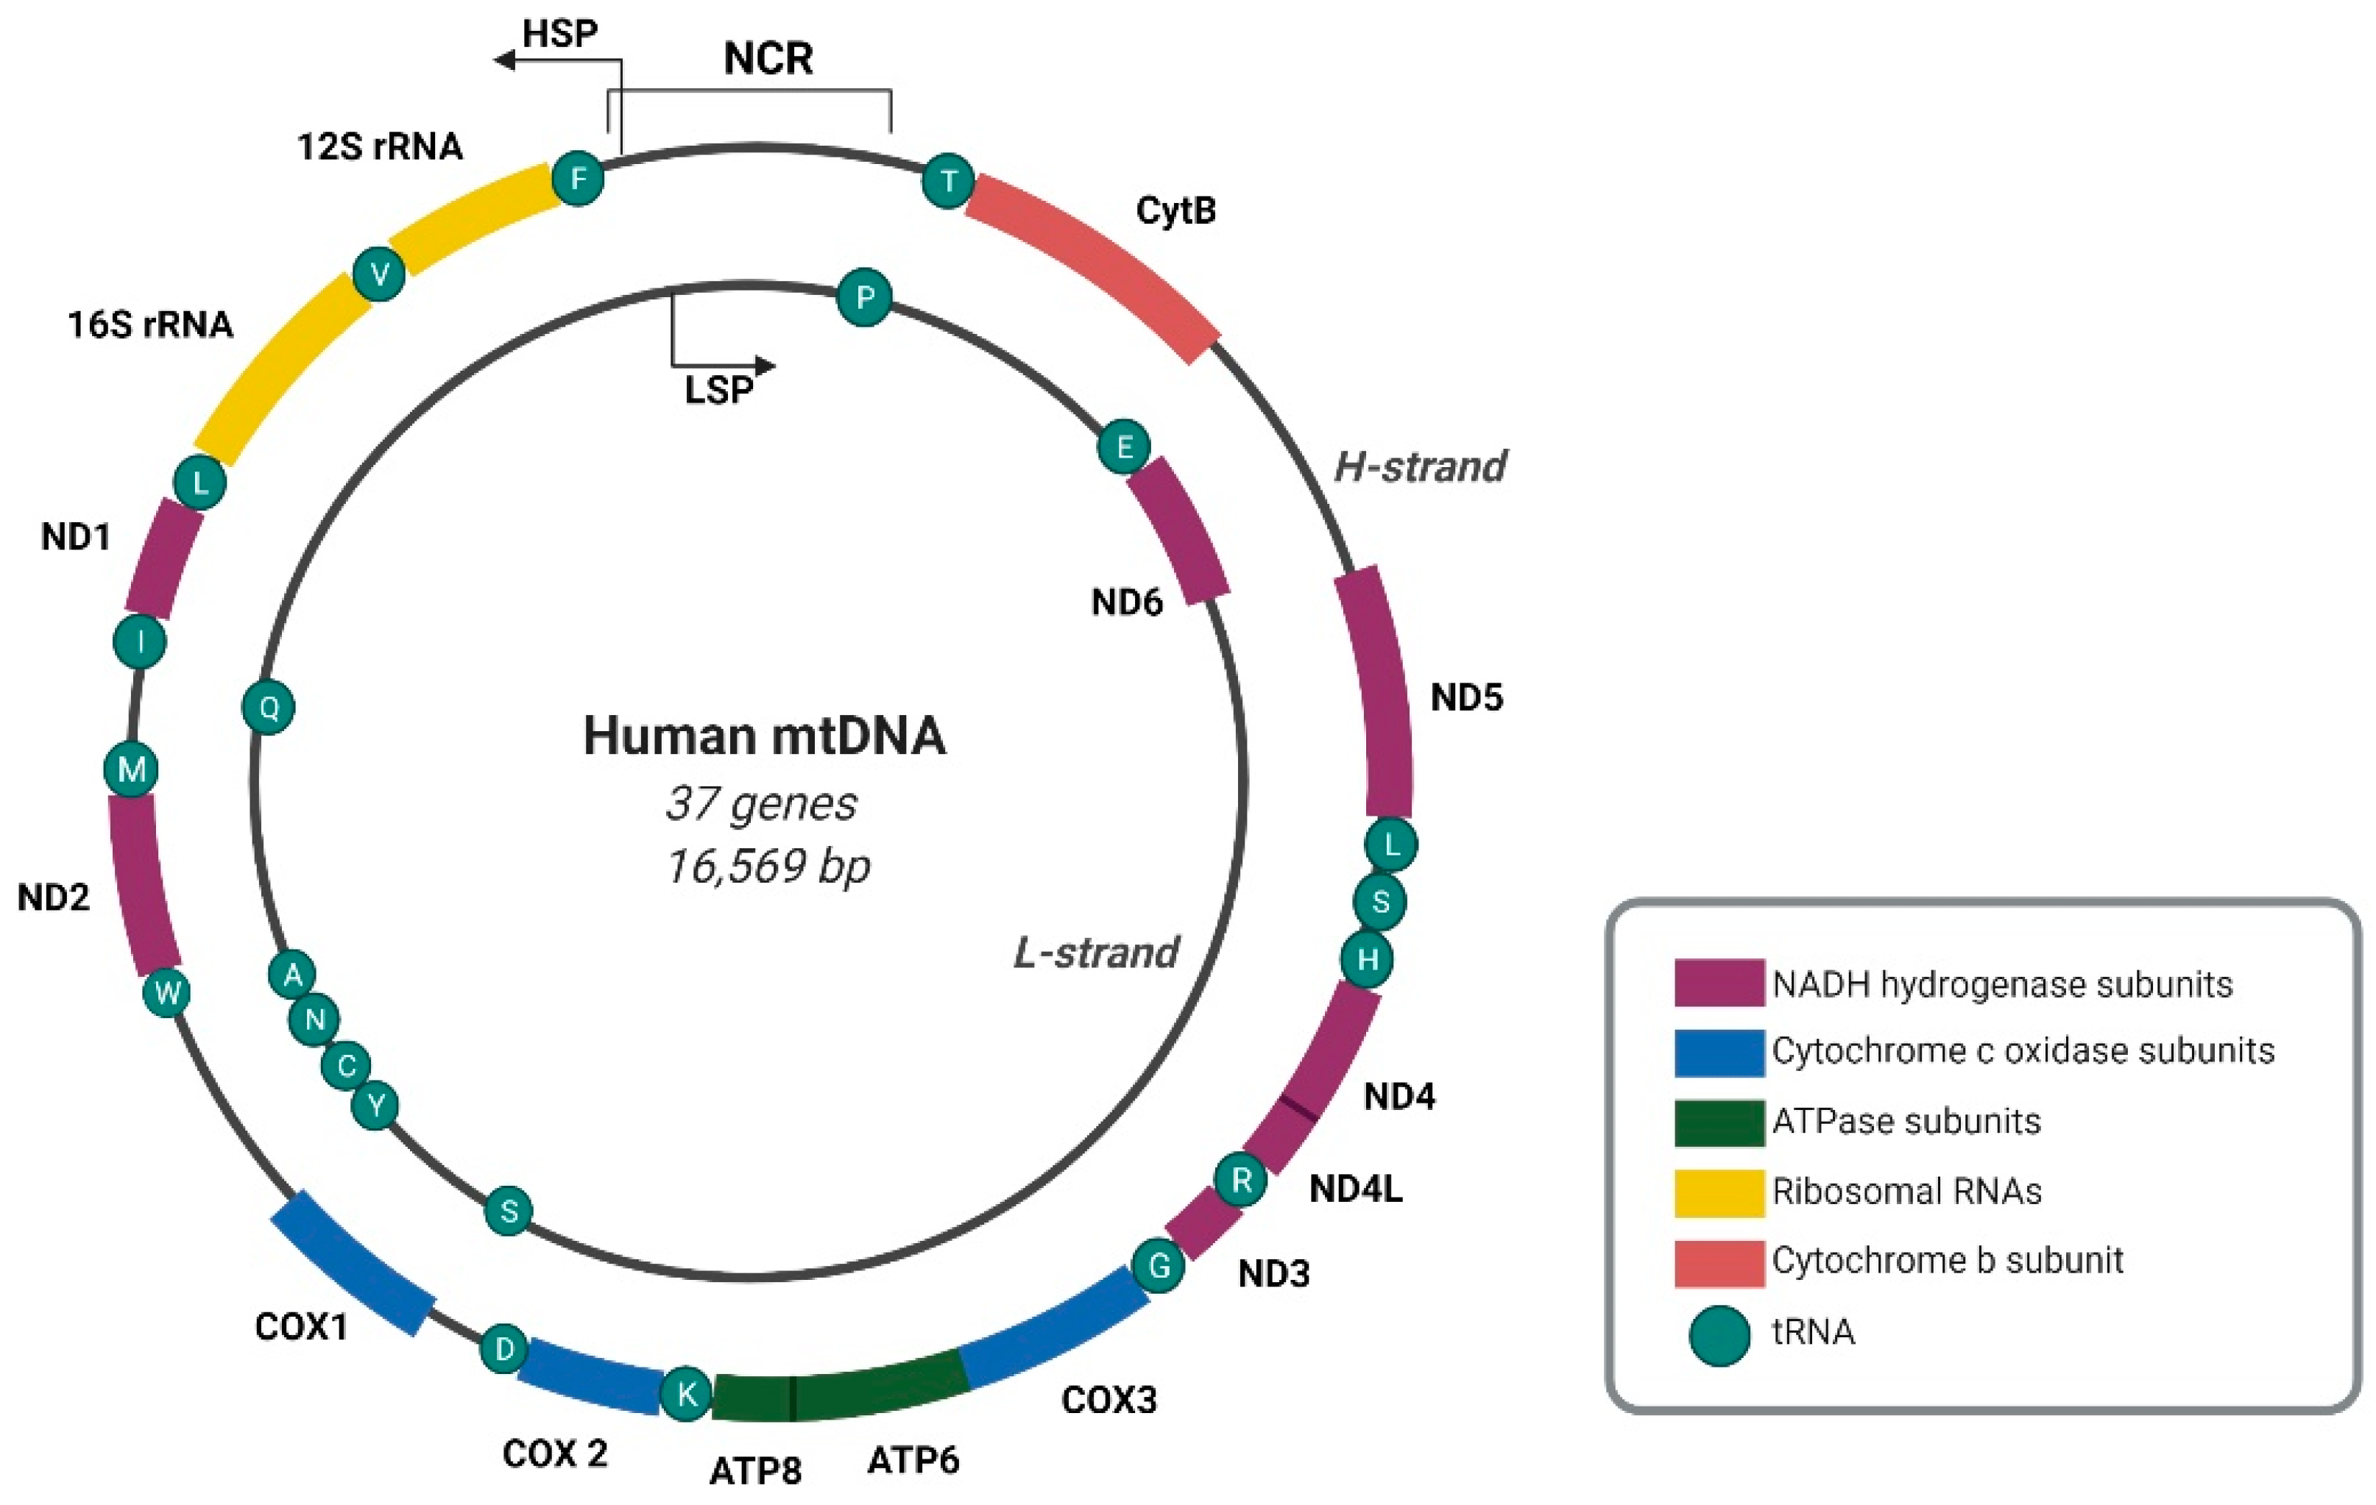
https://www.google.com/url?sa=i&url=https%3A%2F%2Fwww.mdpi.com%2F1422-0067%2F22%2F15%2F7999%2Fhtm&psig=AOvVaw0mR7FO5Af_JvxmsEFC_w_P&ust=1638813635949000&source=images&cd=vfe&ved=0CAwQjhxqFwoTCPC8p9mezfQCFQAAAAAdAAAAABBB

Slide 22
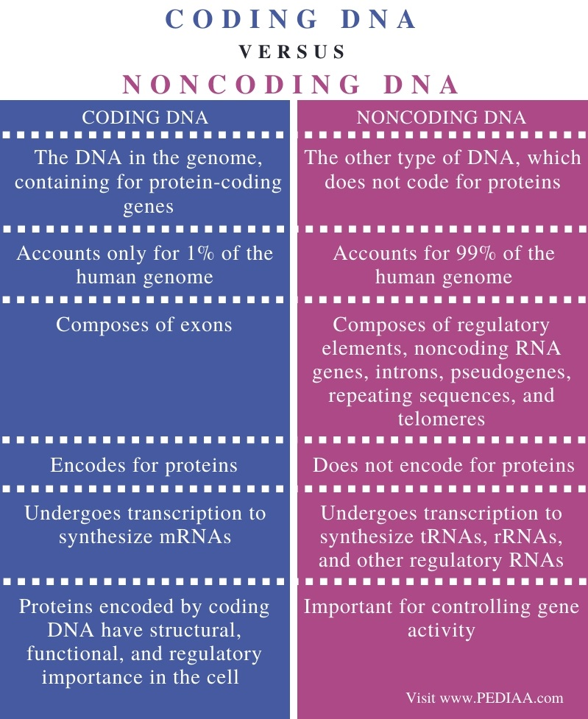

Slide 23
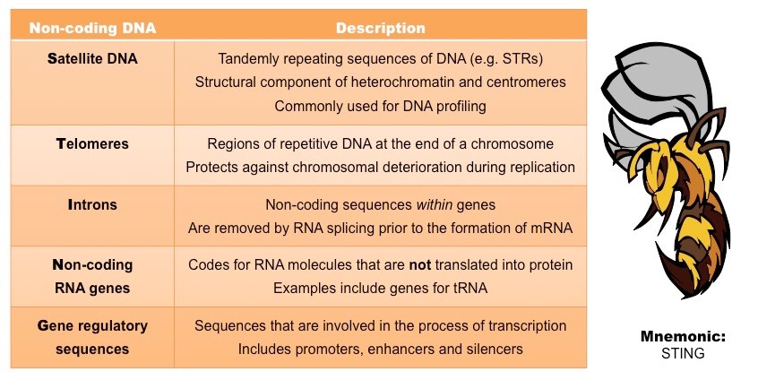
https://www.google.com/url?sa=i&url=http%3A%2F%2Fib.bioninja.com.au%2Fhigher-level%2Ftopic-7-nucleic-acids%2F71-dna-structure-and-replic%2Fnon-coding-dna.html&psig=AOvVaw1RYAwMokIj3VJG99IRaVr6&ust=1638797212197000&source=images&cd=vfe&ved=0CAwQjhxqGAoTCLjc3sPhzPQCFQAAAAAdAAAAABCJAQ

Slide 24
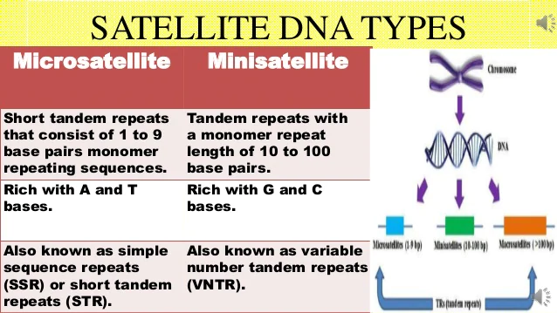

Slide 25
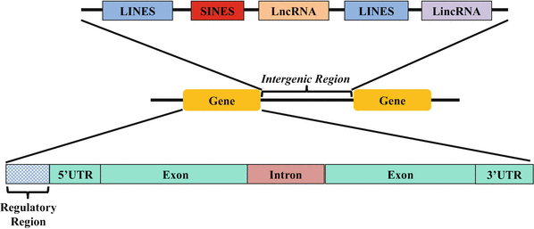
https://www.google.com/url?sa=i&url=https%3A%2F%2Flink.springer.com%2F10.1007%2F978-3-319-47829-6_64-1&psig=AOvVaw0rV1x_RmKwMdRQW_jjjlV9&ust=1638791813671000&source=images&cd=vfe&ved=0CAwQjhxqFwoTCLiDp7rNzPQCFQAAAAAdAAAAABAS

Slide 26
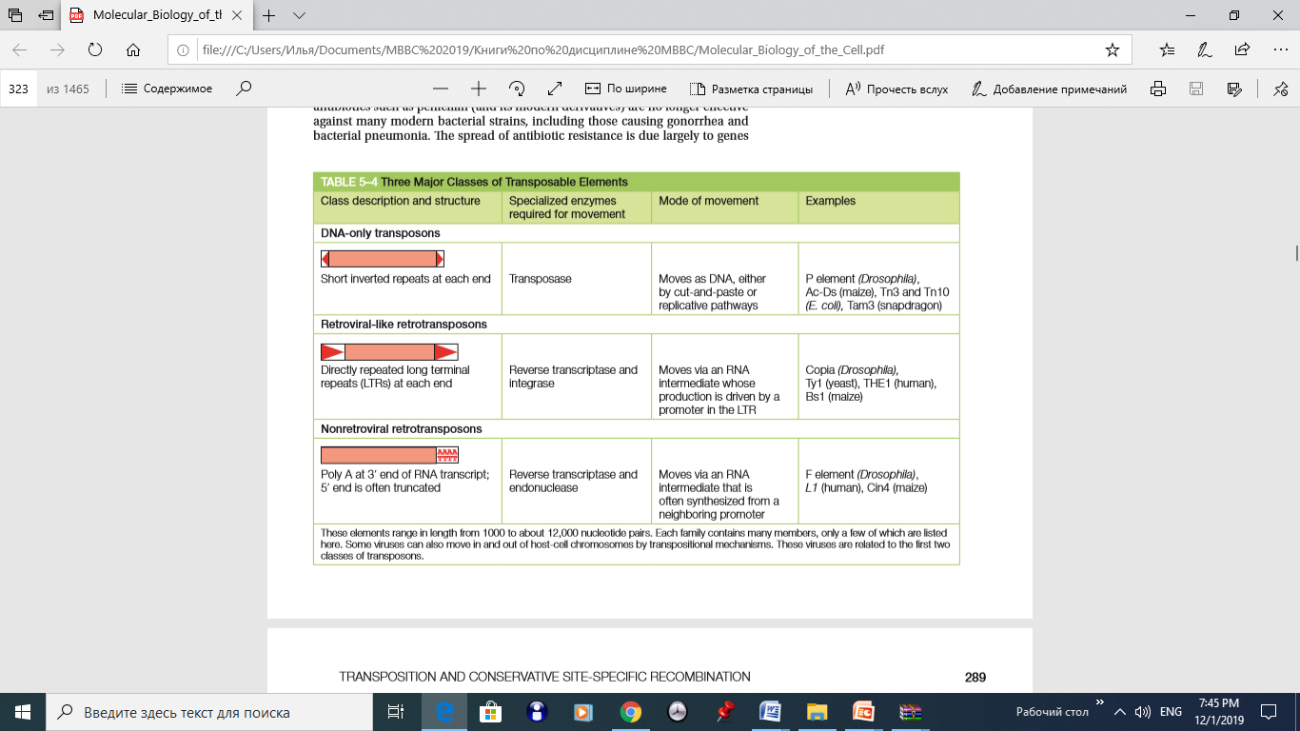

Slide 27
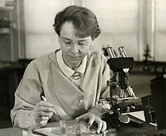
Mobile genetic elements were discovered by Barbara McClintock during the 1940s and 1950s. She was awarded the 1983 Nobel Prize in Physiology and Medicine for this discovery.

Slide 28
References
1. "WHO definitions of genetics and genomics". World Health Organization.
2. Marsden RL, Lewis TA, Orengo CA (March 2007). "Towards a comprehensive structural coverage of completed genomes: a structural genomics viewpoint". BMC Bioinformatics. 8: 86. doi:10.1186/1471-2105-8-86. PMC 1829165. PMID 17349043.
3. Brenner SE, Levitt M (January 2000). "Expectations from structural genomics". Protein Science. 9 (1): 197–200. doi:10.1110/ps.9.1.197. PMC 2144435. PMID 10739263.
4. McElheny VK (2010). Drawing the Map of Life: Inside the Human Genome Project. Basic Books. ISBN 978-0-465-03260-0. 361 pages. Examines the intellectual origins, history, and motivations of the project to map the human genome; draws on interviews with key figures.
5. Alberts B. et al. Molecular biology of the cell. 6th ed. 2015. Garland Science.

